Slide 1

MYAT THINZAR HOTEL
Nay Pyi Taw, Myanmar
Hotel Presentation
2016 - 2017

Slide 2
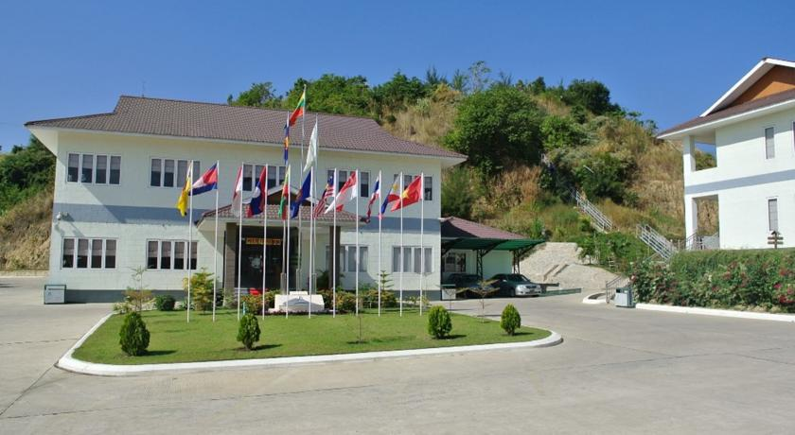
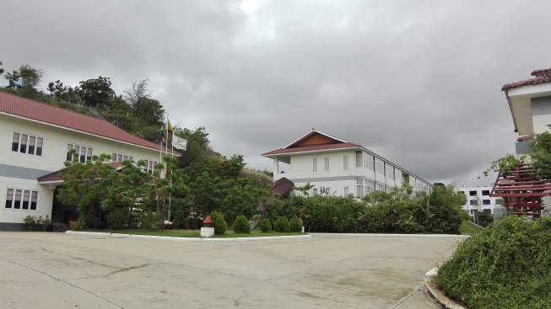
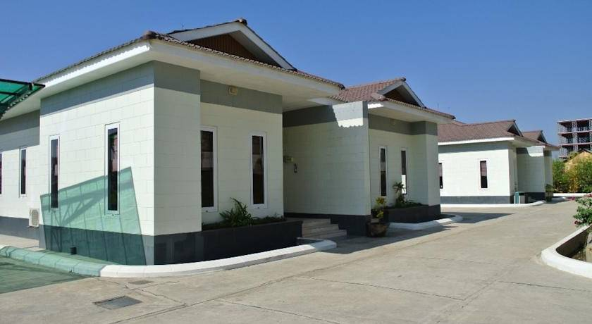
Hotel Information
This hotel was established by the Myat Thinzar Co., Ltd in the month of April 2011. The project was divided into two phases. Phase one started in April 2011 and finished in December 2011. Soft opening held on 19th December 2011. There are 6 bungalows and one two-story building, total of 28 rooms with 16 Superior and 12 Executive Suite opened for the phase one.
Hotel complex is a graceful blend of nature and contemporary elegance surrounded with swaying plants and landscaped gardens.

Slide 3
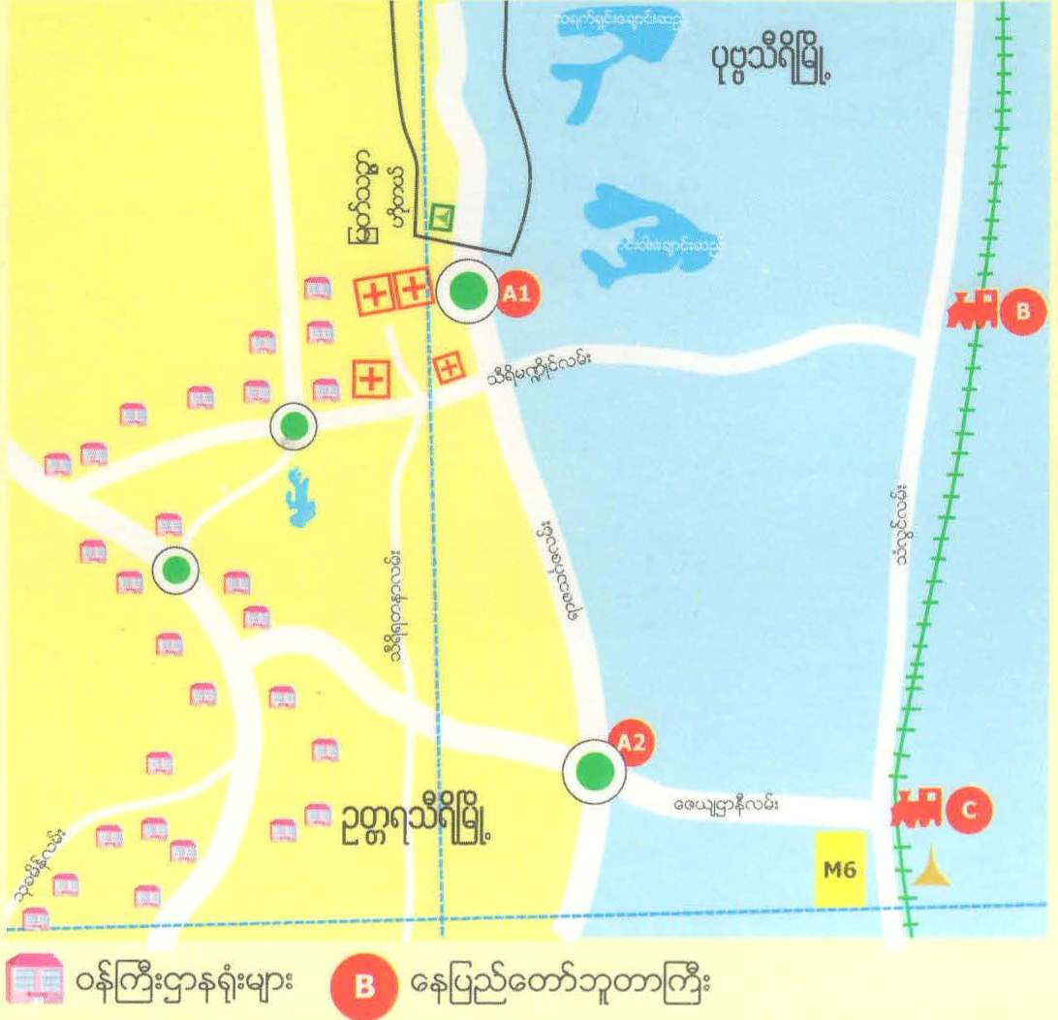
Hotel Location
Hotel is located on the Pobba Thiri Circular Street, Hotel Zone 2, Oattara Thiri Township, which is just 10 minutes drive to Nay Pyi Taw Railway Station and Government Ministries Offices, 20 minutes drive from Nay Pyi Taw Highway Bus Station and National Land Mark Gardens and
Nay Pyi Taw Zoological Garden and Safari Garden.
No 19, Pobba Thiri Circular Street, Hotel Zone 2,
Oattara Thiri Township, Myanmar.
Tel: (95-67) 435051 - 61 Fax: (95-67) 435055
Mobile: (95-9)977 838 088, (95-9)977 838 089
Email: gm.mtz@ayswco.com, info.mtz@ayswco.com
Myat Thinzar Hotel
ေနျပည္ေတာ္ ဘူတာရံုႀကီး
၀န္ႀကီးဌာနမ်ား
မဂၤလာအ၀ိုင္း
Nay Pyi Taw Railways Station
Government Ministries
အင္ၾကင္းပိုင္းအ၀ိုင္း
ရြာေတာ္ဘူတာ
မဂၤလာေစ်း

Slide 4
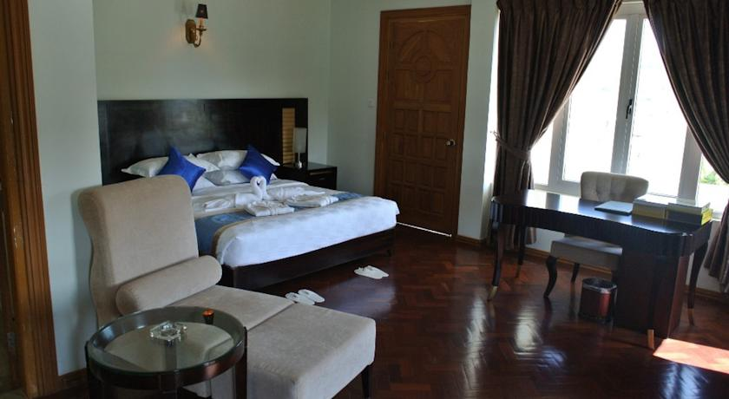
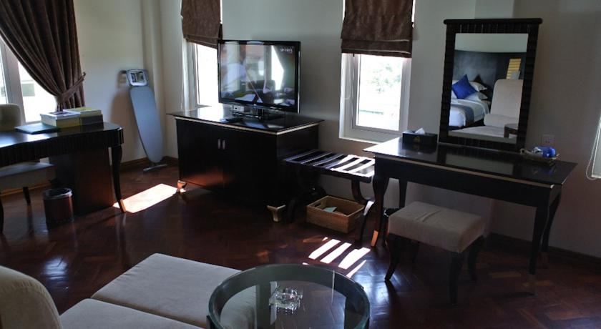
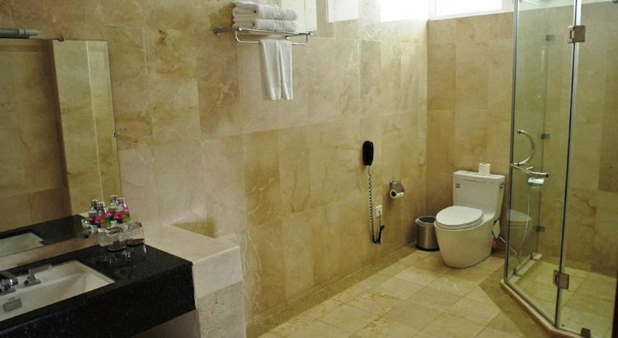
Suites & Rooms
12 Executive Suite Rooms 16 Superior Rooms
Executive Suite Room
The Executive Suite Room high lights spacious living room separate from bed room and decorated with exclusive furnishing and amenities to accommodate our guests.
In-Room Facilities
Hot and Cold Shower Bathrobe & Towel Hair Dryer
Bathroom Amenities Slippers Iron & Ironing Board
Twin or Double Bed Internet Access Working Desk
Satellite TV Fully stocked Mini Bar Water Bottle
In Room safe Electric Kettle / Tea and Coffee In Room Telephones
Night turn down service

Slide 5
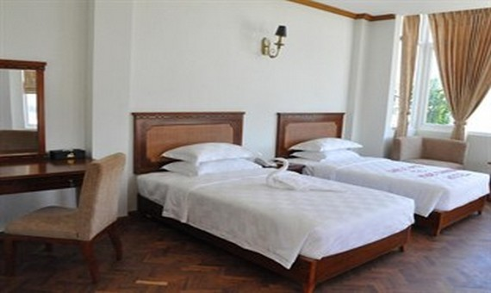
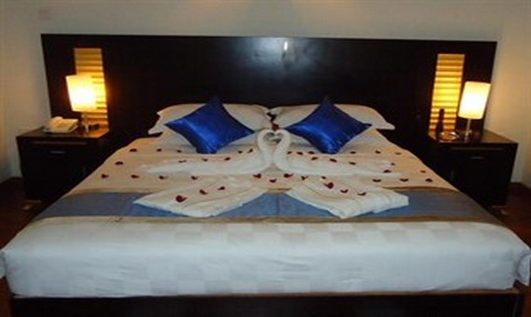
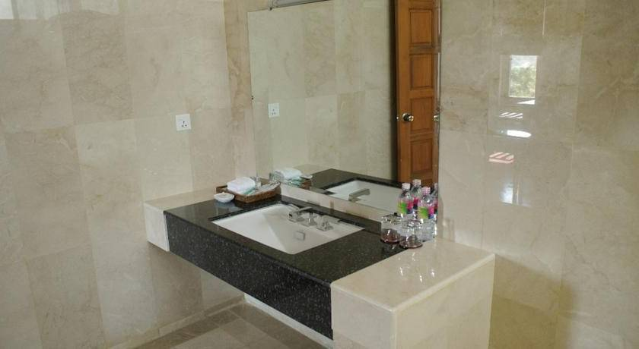
Suites & Rooms
12 Executive Suite Rooms 16 Superior Rooms
Superior Room
Superior Room furnished with modern furnishers and well thought layout along with traditional amenities to accommodate our guests.
In-Room Facilities
Hot and Cold Shower Towel Hair Dryer
Bathroom Amenities Slippers Electric Kettle / Tea and Coffee
Twin or Double Bed Internet Access Working Desk
Satellite TV Fully stocked Mini Bar Water Bottle
In Room Telephones Night turn down service

Slide 6
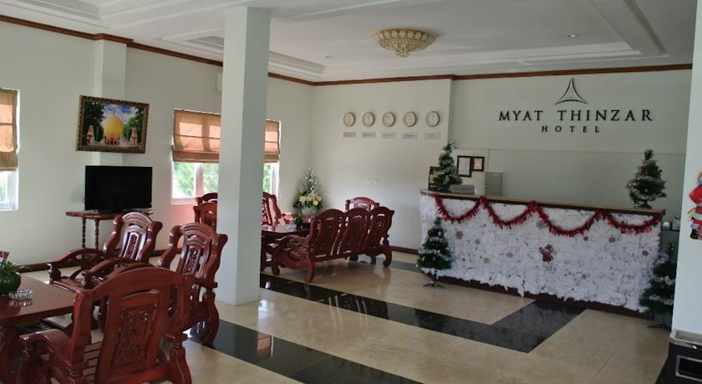
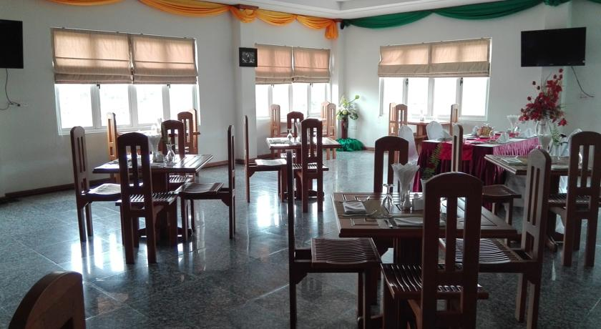
Services & Facilities
24 hours Reception Desk
FREE WiFi in rooms
Limousine Service
80 seats capacity Restaurant
Room Service
Business Center
Laundry Service
Massage Parlor
Garden Bar with lovely flowers
Catering Service and other Event planner
Ticketing Service
Medical assistance on call

Slide 7
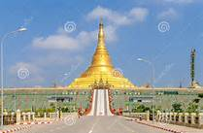
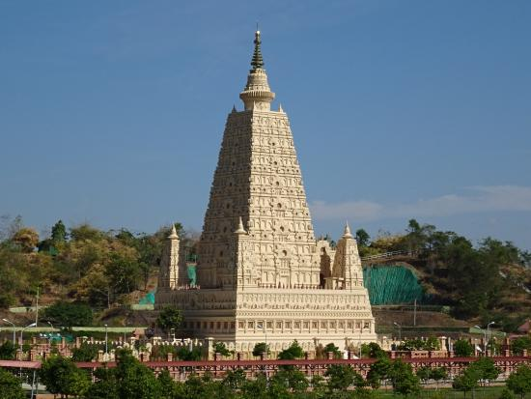
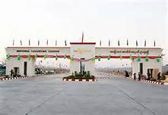
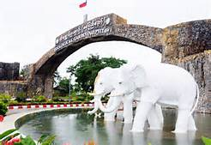
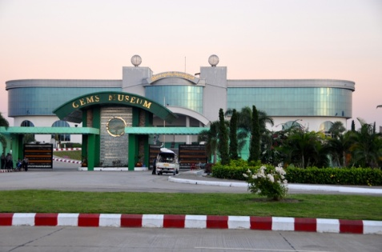
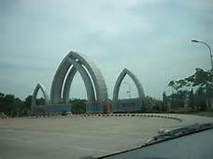
Leisure Activities
Start the to from Thatta Htarna ; a replica of Buddha Gaya in India, where the seven sacred spots of the Lord Buddha in his early Buddha-hood is located.
Later on, visit to The National Land Marks Garden; which is depicting the replicas of the famous Pagodas, Stupas, Caves, River Crossing Bridges, Mountains, Lakes, Water Falls, Beaches and Islands in States and Divisions in Myanmar.
The Zoological Garden; the biggest Zoo in Myanmar, covering about 200 hectares (500 acres) and is home to 430 animals, representing 81 species.
Safari Park; next to the Zoological Garden, the first in its kind in Myanmar to offer visitors the opportunity of seeing wild animals in a natural environment.
In the evening, visit to Uppatasanti Pagoda; a replica of the magnificent world famous Shwedagon Pagoda in Yangon. Dinner and have a stroll in Water Fountain Park which hosts a musical light show at nights.

Slide 8
SWOT Analysis
STRENGTHS:
Room facilities are Cleaned and Comfortable.
Room Architectures as Modern Style according to our Guest Comments.
Location is very interesting and we can create Better Landscaping and even can get more rooms.
Same family business of Elite Express Bus Service which we can promote.
Hotel compound is located at very Quite Place and far from local public quarters.
To emphasize on Wooden Furniture and local materials. It is memorize to our Hotel from Guests.
Easy reach of National Land Mark, Nay Pyi Taw Train Station, Government Offices and Thatta Htarna ; a replica of Buddha Gaya in India.

Slide 9
SWOT Analysis
WEAKNESS
The Hotel has not been success in the Market.
Number of rooms not enough rooms for good sales point and least advantage for group. The rooms are same size for same type.
Not Chain-Type Hotel and operate individually.
Very rare having chance to have Food Festivals or Cultural Show.
Not Sound proof between Guest Rooms.
Two seasons which is high and low seasons (low season period is long for 6 months.)
Up-grade Standard facilities in room and utensils (e.g. Bath room amenities)
Hot water System. (80 Liters using attached four rooms.)
Construction on Septic Tank System.
Almost using Tube well water. It is disadvantage to water pipe line system and water heater pots.
Arrangement of proper store room, linen room, office room and meeting room.
Not using professional management software / International Software.
Only a few peoples are passing the Hotel front location was not very attractive and.

Slide 10
SWOT Analysis
OPPORTUNITIES
To get Standard brand and could build strong Management Team to manage any other properties.
Hotel is Mid-Market and can go to many different levels or Travel Agents.
Having Opportunities to present to locals and visitors to be one of the best Myanmar Food and European Food in Nay Pyi Taw.
Should implement “Staff welfare Committee” to get strong and united Team.
It might be Opportunity to promote Hotel Zone 2 together with other Hotels to be better destination.

Slide 11
SWOT Analysis
THREATS
Economic Crises in World.
Base on Political.
More Competitors near our Property.
Costs are highly value even in Locality.

Slide 12
SWOT Matrix
To develop strategies that take into account the S.W.O.T profile, a matrix of these factors can be constructed. The S.W.O.T matrix (also known as a T.O.W.S Matrix) is shown below:
S-O strategies pursue opportunities that are a good fit to the company's strengths. ***
W-O strategies overcome weaknesses to pursue opportunities.
S-T strategies identify ways that the firm can use its strengths to reduce its accountability to
external threats.
W-T strategies establish a defensive plan to prevent the firm's weaknesses from making it
highly susceptible to external threats.
S.W.O.T / T.O.W.S Matrix
Strengths
Weaknesses
Opportunities
S-O strategies
W-O strategies
Threats
S-T strategies
W-T strategies

Slide 13
Market Segmentation
The division of a market into different homogeneous groups of consumers is known as market segmentation.
A market segment should be:
Measurable
Access by communication and distribution channels
Different in its response to a marketing mix
Durable (not changing too quickly)
Substantial enough to be profitable

Slide 14
Consumer
Market Segmentation
Geographic segmentation is based on regional variables such as region, climate,
population density, and population growth rate.
2. Demographic segmentation is based on variables such as age, gender, ethnicity,
education, occupation, income, and family status.
Psychographic segmentation is based on variables such as values, attitudes, and
lifestyle.
Behavioral segmentation is based on variables such as usage rate and patterns, price
sensitivity, brand loyalty, and benefits sought.

Slide 15
Marketing MIX
4 P’s of Marketing
PRODUCT
PRICE
The product is the physical product or service offered to the consumer. In the case of physical products, it also refers to any services or conveniences that are part of the offering.
Product decisions include aspects such as function, appearance, packaging, service, warranty, etc.
Pricing decisions should take into account profit margins and the probable pricing response of competitors. Pricing includes not only the list price, but also discounts, financing, and other options such as leasing.
TARGET MARKET
PLACE
PROMOTION
Place (or placement) decisions are those associated with channels of distribution that serve as the means for getting the product to the target customers. The distribution system performs transactional, logistical, and facilitating functions.
Distribution decisions include market coverage, channel member selection, logistics, and levels of service.
Promotion decisions are those related to communicating and selling to potential consumers. Since these costs can be large in proportion price, a break even analysis should be performed when making promotion decisions. It is useful to know the value of a customer in order to determine whether additional customers are worth the cost of acquiring them.
Promotion decisions involve advertising, public relations, media types, etc.

